Slide 1

Analysis of Algorithm
Lecture 5

Slide 2
Efficiency of Algorithms
The empirical (or a posteriori) Approach
The empirical (or a posteriori) approach to choosing an algorithm consists of programming the computing techniques and trying them on different instances with the help of a computer.
The theoretical (or a priori) Approach
The theoretical (or a priori) approach, which we favor consists of determining mathematically the quantity of resources needed by each algorithm as function of the size of the instances considered. The resources of most interest are: computing time (most critical) and storage space.
Throughout the class when we speak of the efficiency of an algorithm, we shall mean how fast it runs. Occasionally, we'll also be interested in an algorithm's storage requirements or any other resources (like number of processors required by a parallel algorithm).
.

Slide 3
Efficiency of Algorithms
The size of an instance corresponds formally to the number of bits needed to represent the instance on a computer.
To be less formal in analysis, the use of “size” to mean any integer that in some way measures the number of components in an instance. Examples: . In sorting size is the number of elements to be sorted. . In graphs size is the number of nodes or edges or both.
The advantage of the theoretical approach is that it doesn't depend on the computer used, nor the programming language, nor the skill of the programmer.
Hybrid approach
There is the hybrid approach where efficiency is determined theoretically, then any required numerical parameters are determined empirically for a particular program and a machine.

Slide 4

Average and worst-case Analysis
• Sorting by Insertion algorithm
-The best case input is an array that is already sorted. In this case insertion sort
has a linear running time (i.e., Θ(n)). During each iteration, the first remaining
element of the input is only compared with the right-most element of the
sorted subsection of the array.
The worst case input is an array sorted in reverse order. In this case every
iteration of the inner loop will scan and shift the entire sorted subsection of the
array before inserting the next element. For this case insertion sort has a
Quadratic running time (i.e., O(n²)).
The average case is also quadratic, which makes insertion sort not
practical for sorting large arrays.
-
-

Slide 5
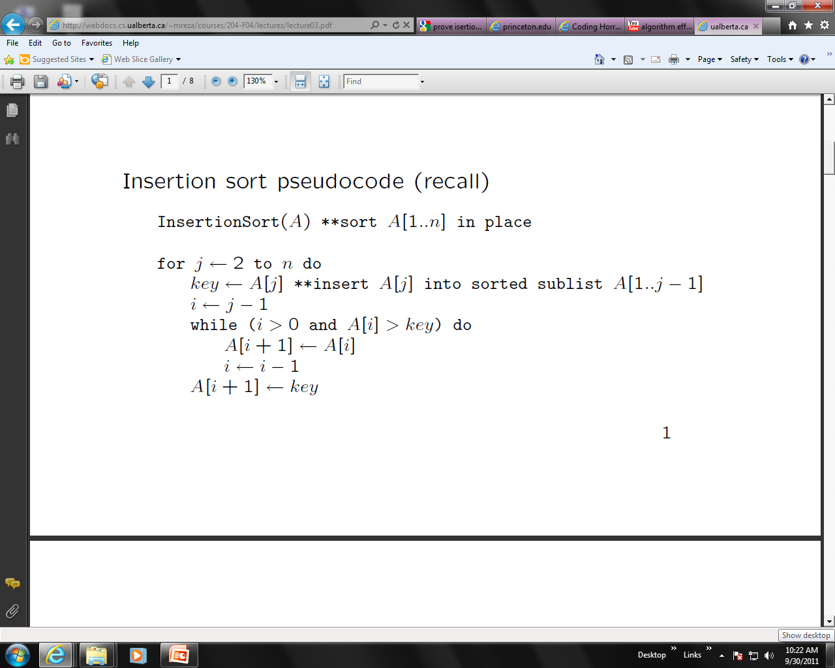
Insertion sort pseudocode (recall)
InsertionSort(A) **sort A[1..n] in place
for j 2 to n do
key A[j] **insert A[j] into sorted sublist A[1..j − 1]
i j − 1
while (i > 0 and A[i] > key) do
A[i+1] A[i]
i i − 1
A[i+1] key
1
5 7 0 3 4 2 6 1 (0)
5 7 0 3 4 2 6 1 (0)
0 5 7 3 4 2 6 1 (2)
0 3 5 7 4 2 6 1 (2)
0 3 4 5 7 2 6 1 (2)
0 2 3 4 5 7 6 1 (4)
0 2 3 4 5 6 7 1 (1)
0 1 2 3 4 5 6 7 (6)

Slide 6
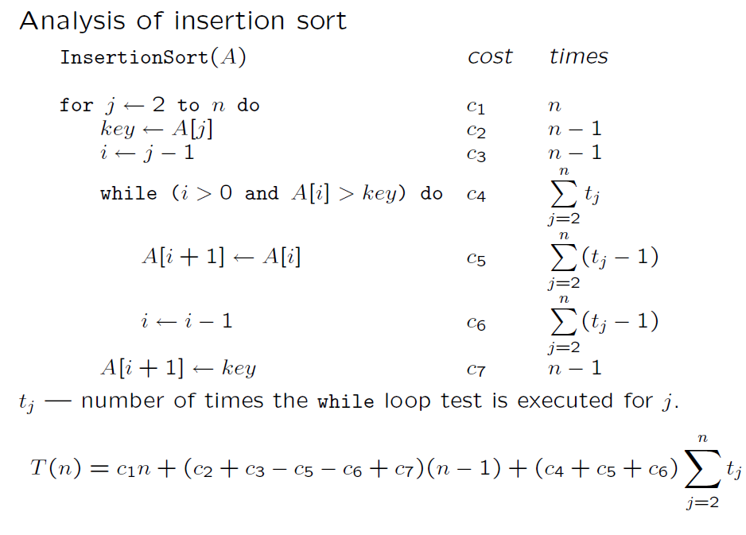

Slide 7
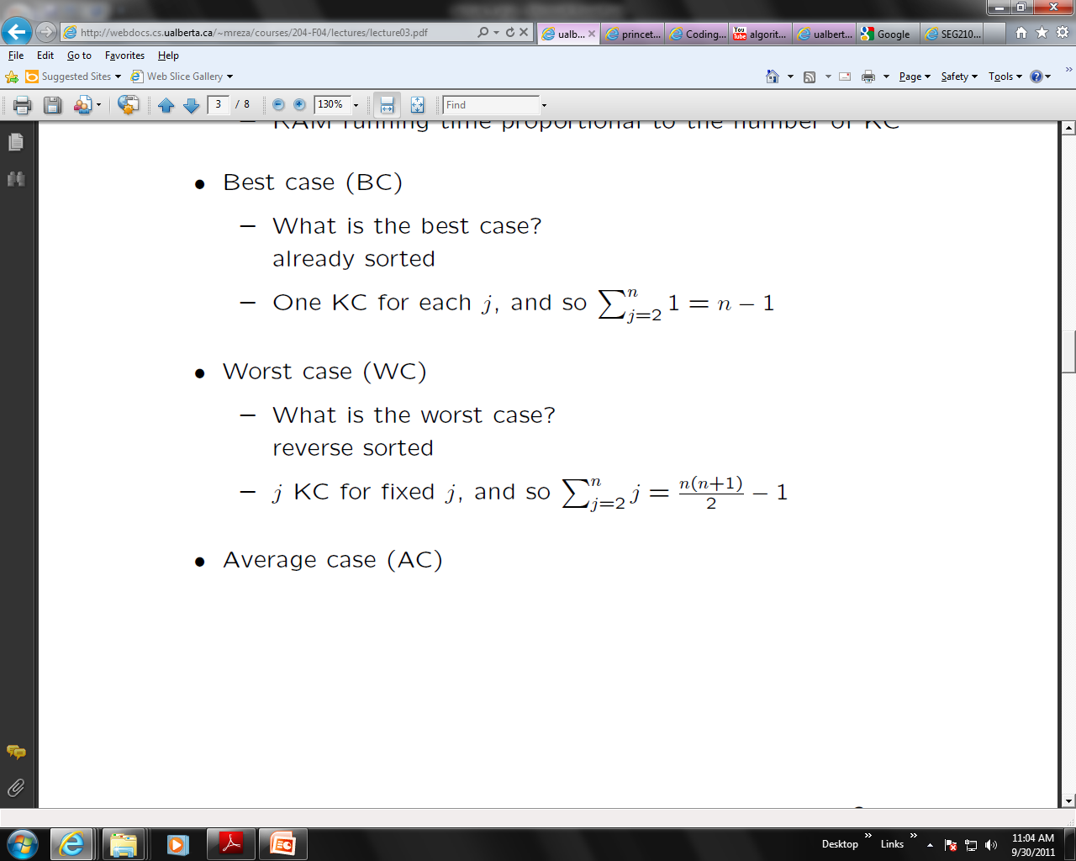
Quick Analysis
Quadratic running time (i.e., O(n²))
Notes:
Kc : Key comparison

Slide 8

Shell Sort
•
Uses insertion sort on periodic subsequences of the input to produce a
faster sorting algorithm.
•
Algorithm sorts an array with n elements.
•
The subsequences to be sorted are determined by increments (ht, ht-1,…..,
h1).
•
The number of subsequences are obtained by the number of increments
(h values).
• Provides better performance due the fact that when the last passes are
made using small increments, few elements will be out of order because of all the work that was done in earlier passes.
• The number of comparisons done by Shell sort is a function of the
sequence of increments used so a complete analysis is extremely difficult.
•
It has been shown that the best choice of h is approximately 1.72
3 n
and with this choice the average running time is proportional to n5/3.
• The Average - case :
C(n) = O(n^{5/3}) when h = 1.72
3
n
• The worst - case
:
C(n) = O(n²) when h = 1
• The best - case
:
C(n) = O(n (logn)2) if increments are
carefully chosen for fairly large n
Notes:
Shell's original sequence: N/2 , N/4 , ..., 1 (repeatedly divide by 2);
Hibbard's increments: 1, 3, 7, ..., 2^{k} - 1 ;
Knuth's increments: 1, 4, 13, ..., (3^{k} - 1) / 2 ;

Slide 9
Shellsort
Shell sort is also known as diminishing increment sort.
The distance between comparisons decreases as the sorting algorithm runs until the last phase in which adjacent elements are compared
Not stable
Advantage of Shellsort is that its only efficient for medium size lists. For bigger lists, the algorithm is not the best choice
5 times faster than the bubble sort and a little over twice as fast as the insertion sort, its closest competitor.

Slide 10
Shellsort
Disadvantage of Shellsort is that it is a complex algorithm and its not nearly as efficient as the merge, heap, and quick sorts.
The shell sort is still significantly slower than the merge, heap, and quick sorts, but its relatively simple algorithm makes it a good choice for sorting lists of less than 5000 items unless speed important

Slide 11
Algorithm
The algorithms for shell sort can be defined in two steps
Step 1: divide the original list into smaller lists.
Step 2: sort individual sub lists using any known sorting algorithm (like bubble sort,
insertion sort, selection sort, etc).
Shell Sort

Slide 12
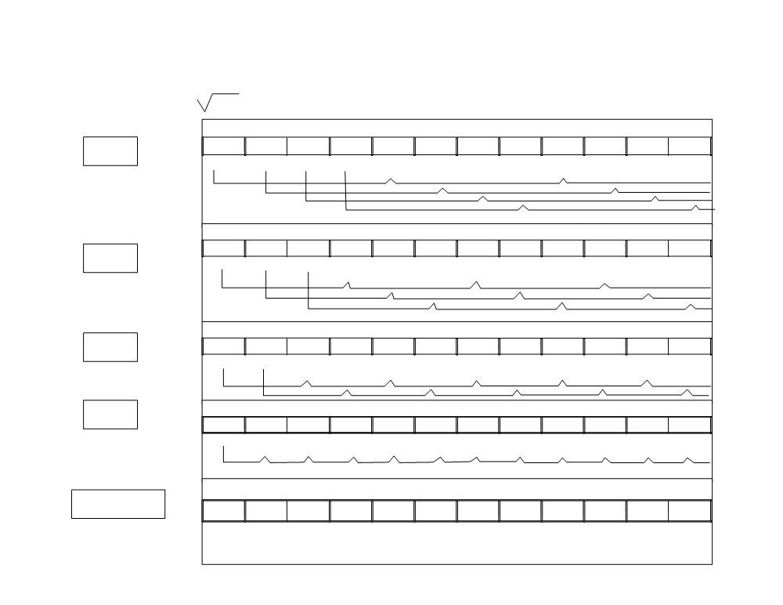
List of numbers: 7 19 24 13 31 8 82 18 44 63 5 29
H = 1.72
3 12 ≈ 4
H4=4
7 19 24
13 31 8 82
18 44 63 5 29
1 2 3
4 5 6 7
8 9 10 11 12
H3=3
7 8 24 13
31 19 5 18
44 63 82 29
1 2 3 4
5 6 7 8
9 10 11 12
H2=2
7
8
19
5
18
24
13
31
29
63
82
44
1
2
3
4
5
6
7
8
9
10
11
12
H1=1
13 24 19 31
29 44 82 63
7 5 18 8
1
2
3
4
5
6
7
8
9
10
11
12
Sorted list
18 19 24 29
31 44 63 82
5 7 8 13
1
2
3
4
5
6
7
8
9
10
11
12

Slide 13
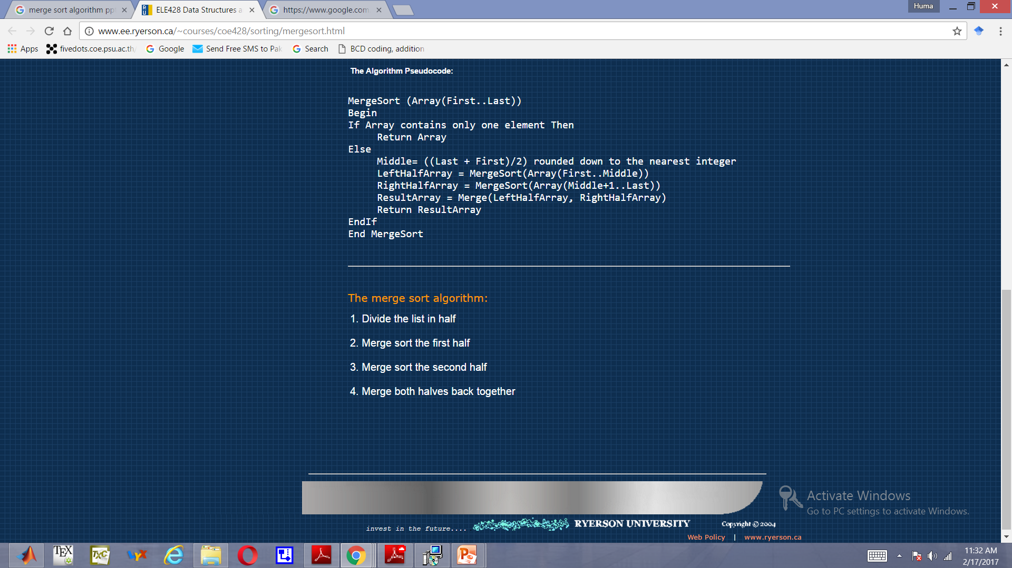
Divide and Conquer Merge Sort

Slide 14
Example – n Power of 2
Divide
1
2
3
4
5
6
7
8
5
2
4
7
1
3
2
6
q = 4
1
2
3
4
5
6
7
8
5
2
4
7
1
3
2
6
1
2
3
4
5
6
7
8
5
2
4
7
1
3
2
6
1
2
3
4
5
6
7
8
5
2
4
7
1
3
2
6

Slide 15
Example – n Power of 2
Conquer
and
Merge
1
2
3
4
5
6
7
8
1
2
2
3
4
5
6
7
1
2
3
4
5
6
7
8
2
4
5
7
1
2
3
6
1
2
3
4
5
6
7
8
2
5
4
7
1
3
2
6
1
2
3
4
5
6
7
8
5
2
4
7
1
3
2
6

Slide 16
Example – n Not a Power of 2
1
2
3
4
5
6
7
8
9
10
11
Divide
4
7
2
6
1
4
7
3
5
2
6
q = 6
1
2
3
4
5
6
7
8
9
10
11
q = 3
4
7
2
6
1
4
7
3
5
2
6
q = 9
1
2
3
4
5
6
7
8
9
10
11
4
7
2
6
1
4
7
3
5
2
6
1
2
3
4
5
6
7
8
9
10
11
4
7
2
6
1
4
7
3
5
2
6
1
2
4
5
7
8
4
7
6
1
7
3

Slide 17
Example – n Not a Power of 2
Conquer
and
Merge
1
2
3
4
5
6
7
8
9
10
11
1
2
2
3
4
4
5
6
6
7
7
1
2
3
4
5
6
7
8
9
10
11
1
2
4
4
6
7
2
3
5
6
7
1
2
3
4
5
6
7
8
9
10
11
2
4
7
1
4
6
3
5
7
2
6
1
2
3
4
5
6
7
8
9
10
11
4
7
2
1
6
4
3
7
5
2
6
1
2
4
5
7
8
4
7
6
1
7
3

Slide 18
Merging
p
q
r
Idea for merging:
Two piles of sorted cards
Choose the smaller of the two top cards
Remove it and place it in the output pile
Repeat the process until one pile is empty
Take the remaining input pile and place it face-down onto the output pile
1
2
3
4
5
6
7
8
2
4
5
7
1
2
3
6
A1← A[p, q]
A[p, r]
A2← A[q+1, r]

Slide 19
Mergesort
Divide the N values to be sorted into two halves
Recursively sort each half using Mergesort
Base case N=1 ➔ no sorting required
Merge the two halves
O(N) operation
Complexity??
We’ll see

Slide 20
Complexity analysis
T(N) = 2T(N/2) + N
Recurrence relation
T(N) = 4T(N/4) + 2N
T(N) = 8T(N/8) + 3N
…
T(N) = 2^{k}T(N/2^{k}) + k*N
For k = log N
T(N) = N T(1) + N log N

Slide 21
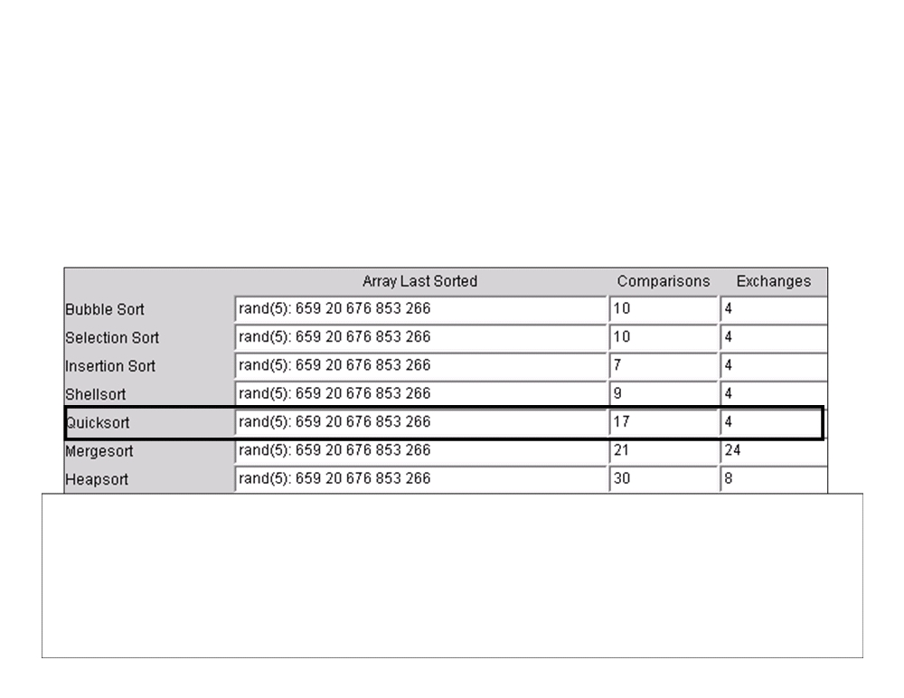
Algorithm Comparison (5 elements)

Slide 22
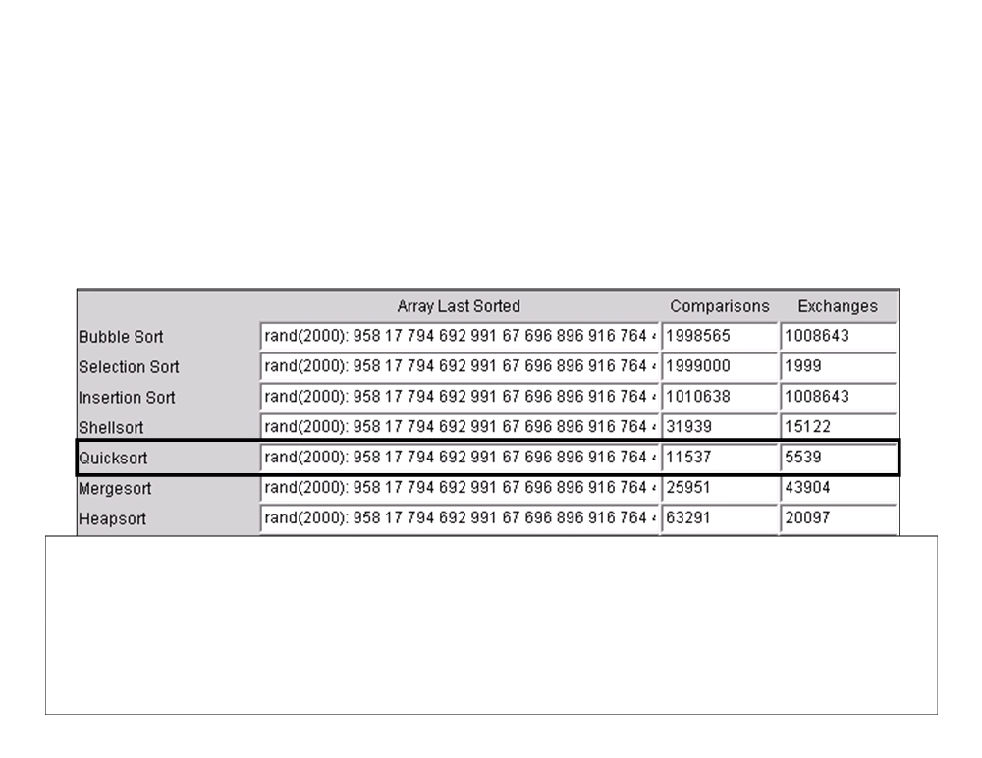
Algorithm Comparison (2K Elements)

Slide 23
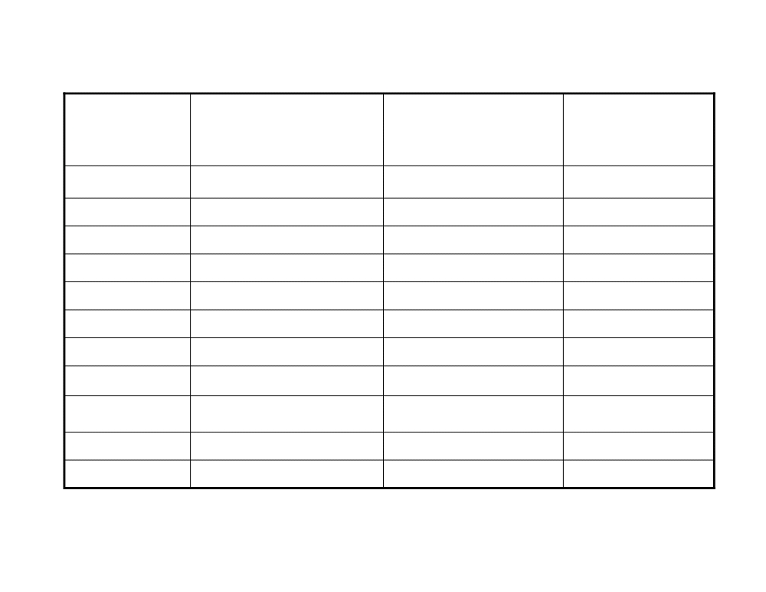
COMPARISON
Sort
Worst
Average
Best
Method
Bubble
O(n
2
)
O(n
2
)
O(n)
Quick
O(n
2
)
O(n log n)
O(log n)
Heap
O(n log n)
O(n log n)
O(log n)
Insertion
O(n
2
)
O(n
2
)
O(n)
Selection
O(n
2
)
O(n
2
)
O(n)
Merge
O(n log n)
O(n log n)
O(log n)
Radix
O(n
2
)
O(s*n)
O(n log n)
Shell
O(n
2
)
O(n
5/3
)
O(n)
Counting
O(n + k)
O(n)
O(n)
Bucket
O(n
2
)
O(n)
O(n)
Pigeonhole
O(n + s)
O(n)
O(n)

